Slide 1
THEORY OF MACHINE (MEC-201A)
Unit – I (A)
Dr. Sandeep
Assistant Professor (Guest Faculty)
Mechanical Engineering Department

Slide 2
TOM
KOM
DOM

Slide 3
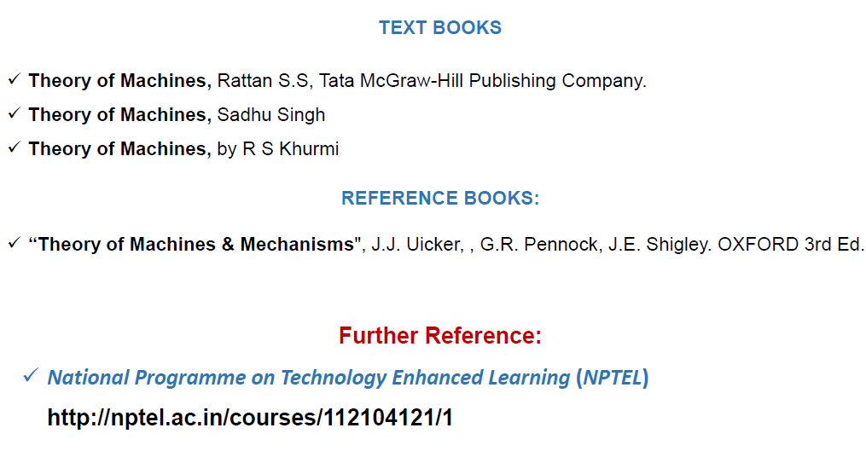

Slide 4
Topic Covered
UNIT-1 Simple Mechanisms
Introduction to machine, classification of motion, kinematic link their classification, nomenclature , structure, constrained motion, Kinematic pairs their classification, kinematics chains, mechanism.

Slide 6
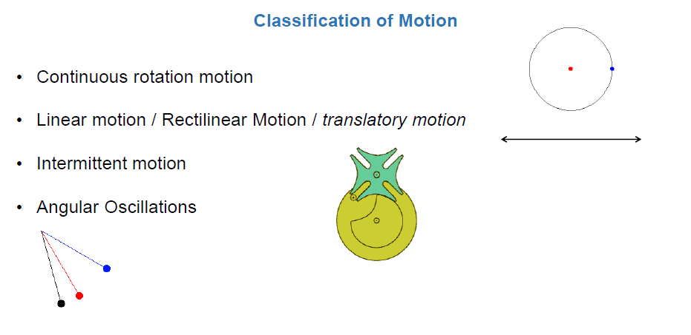

Slide 7
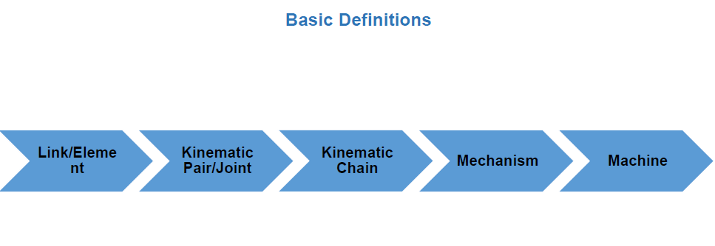

Slide 8
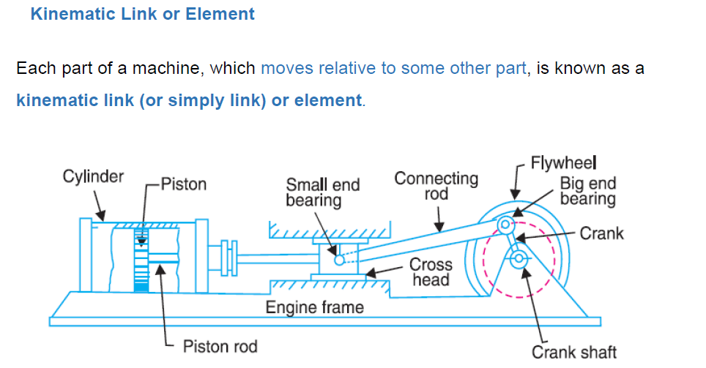

Slide 11
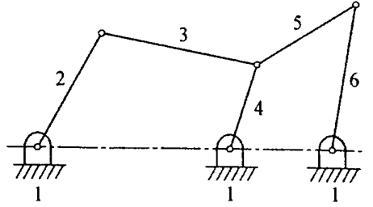
Nomenclature of links
If no any relative motion between the link then all link behave as a same link.
If relative motion will be present in between link then the link will be represent by different name and number.

Slide 12
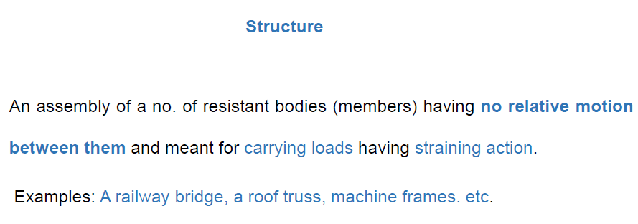

Slide 27
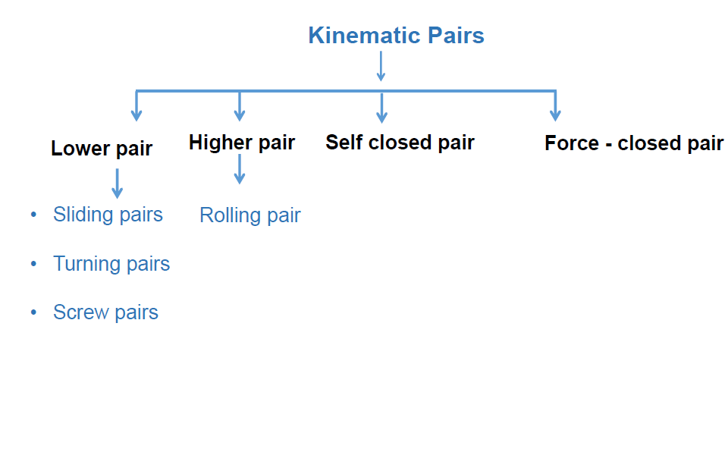

Slide 28
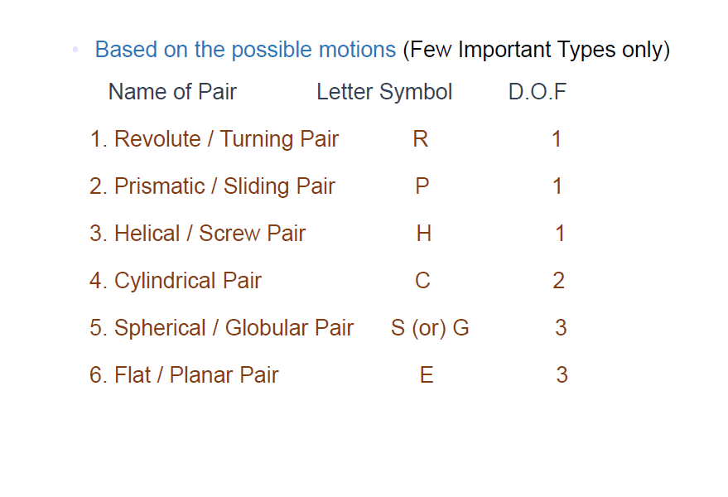

Slide 29
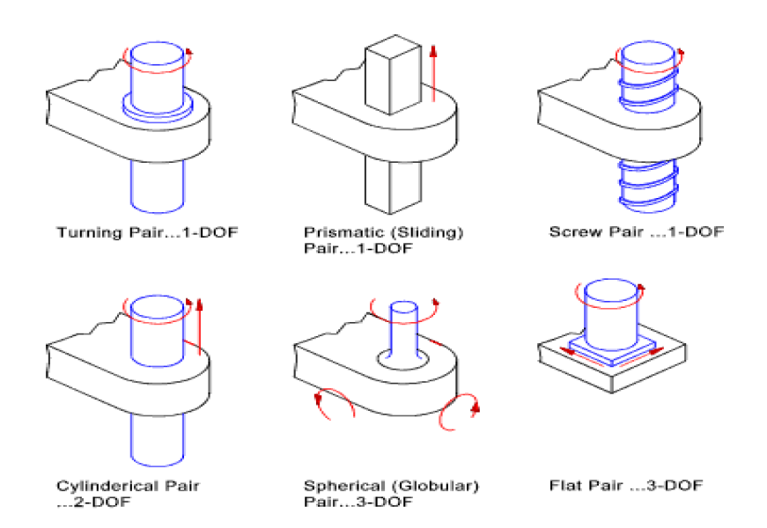

Slide 32
Thanks

